Slide 1
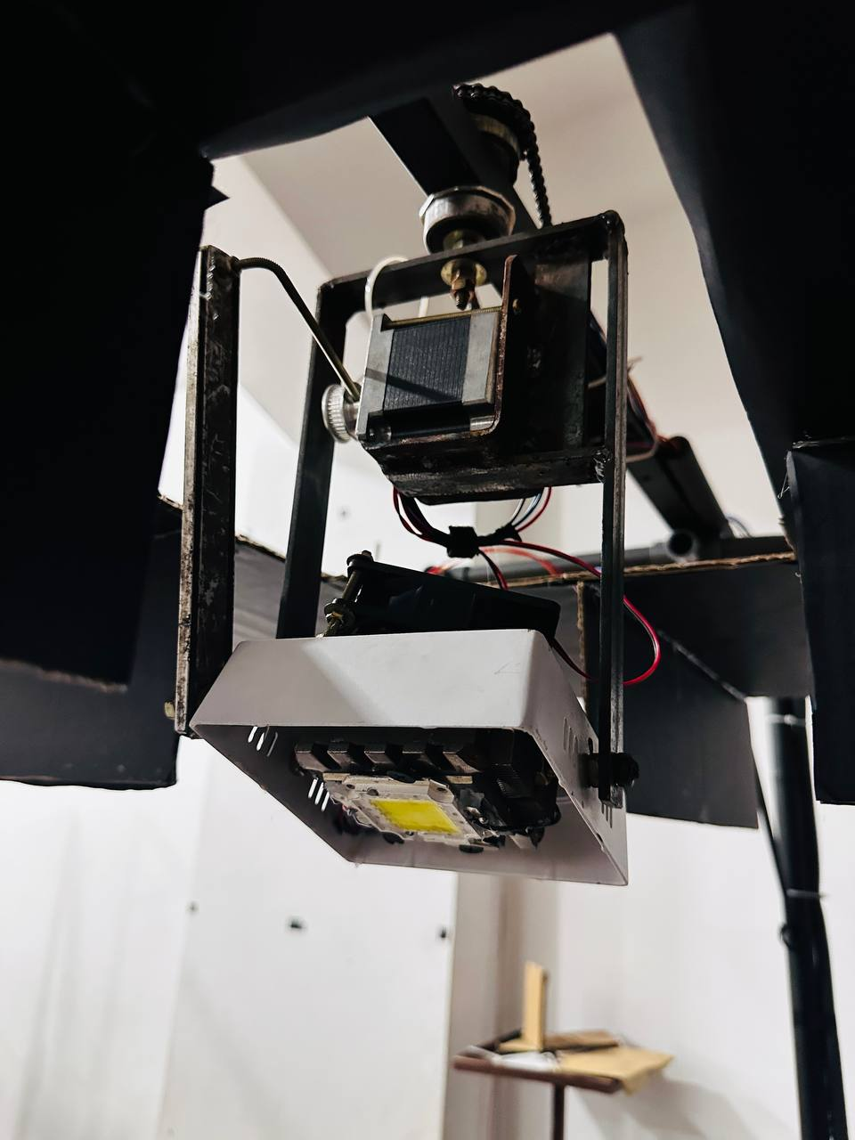
Performance Enhancement using Beam-forming in Visible Light Communication For Multiple Users
SLTC Research University
Faculty of Engineering

Slide 2
Project Team & Supervision
Project Supervisors:
Supervisor - Ms. Dilanka De Silva
Co-Supervisor – Mrs. Kusala Kalani
Group Members:
21UG0496 – M. N. K. M. Bandara
21UG0481 – S. M. S. M. Bandara

Slide 3
Introduction
Introduction to Visible Light Communication (VLC):
Visible Light Communication (VLC) is a wireless communication technology that utilizes visible light as a medium for transmitting data.
VLC offers several advantages, including high bandwidth, immunity to electromagnetic interference, and enhanced security due to its limited range.
Wavelength of 375nm – 780nm

Slide 4
Performance Enhancement by Beamforming:
Beamforming is a signal processing technique used to enhance the performance of communication systems by directing signals towards specific receivers.
In VLC, beamforming can be employed to improve coverage, reliability, and data rates by dynamically adjusting the direction of transmitted light beams.
It optimizes signal transmission, enhances signal-to-noise ratio, and mitigates the effects of multipath propagation, ultimately improving the overall performance of VLC systems.

Slide 5
Literature Review
Previous research on VLC and beamforming techniques.
Orthogonal Frequency Division Multiplexing (OFDM)
Advanced Modulation Schemes
Adaptive Equalization
Hybrid VLC-RF Systems
Through the literature review, we aim to identify gaps, challenges, and opportunities for innovation in VLC system design with a focus on beamforming using photodiodes and LEDs.

Slide 6
Problem to be Solved
Indoor wireless communication faces challenges like limited coverage, interference, and scalability.
Visible Light Communication (VLC) offers a solution but has limitations.
Our project aims to address these limitations through VLC with beamforming.

Slide 7
Selected Method
VLC Beamforming
Photodiodes offer sensitivity to detect modulated light signals transmitted by LEDs.
LEDs provide a reliable means of transmitting data wirelessly in indoor environments.
Combined use of photodiodes and LEDs offers a cost-effective and efficient solution for VLC with beamforming.

Slide 8
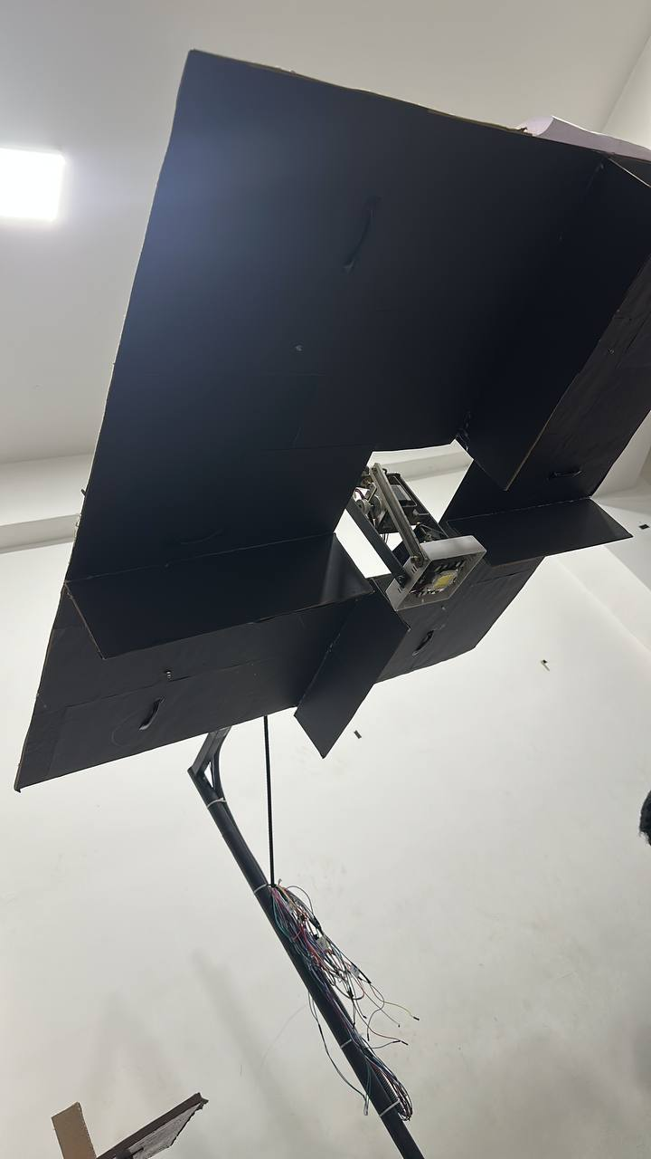
Project Aim
Our project aims to address limitations such as limited coverage, interference and scalability of Visible Light Communications (VLC) with Beamforming.

Slide 9
Objectives
Develop hardware components for the VLC system, including LED arrays and photodetectors.
Develop an algorithm to identify exact user location.
Implement beamforming algorithms for dynamic adjustment of transmitted light beams.
Evaluate system performance through simulations and practical experiments and Optimize beamforming parameters to maximize throughput and minimize interference.
Validate the effectiveness of the proposed solution in real-world scenarios.

Slide 10
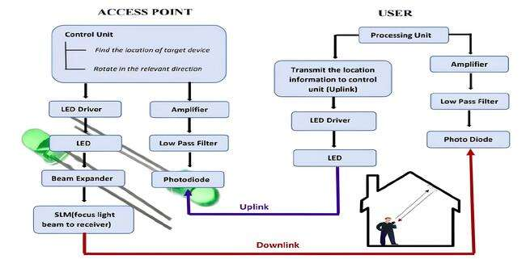

Block Diagram

Slide 11
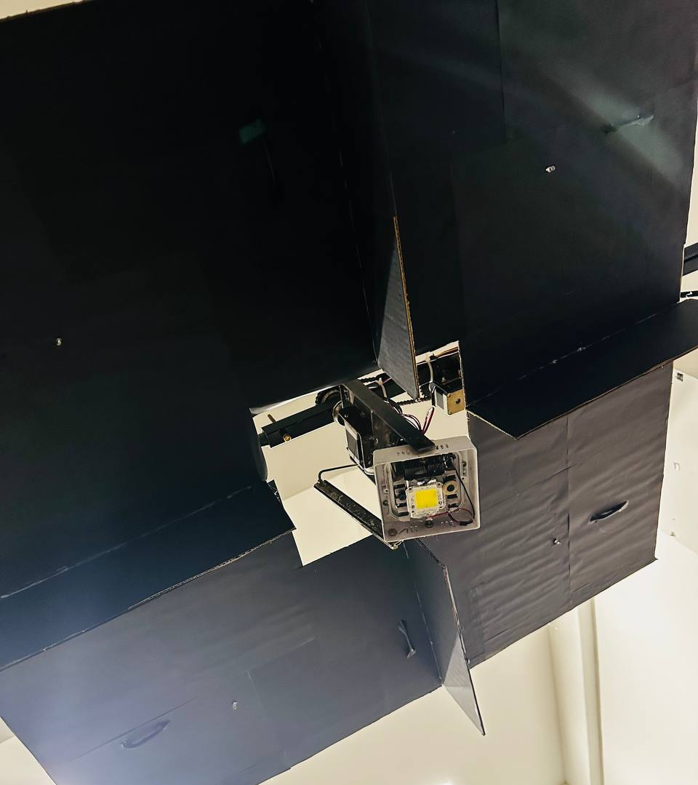
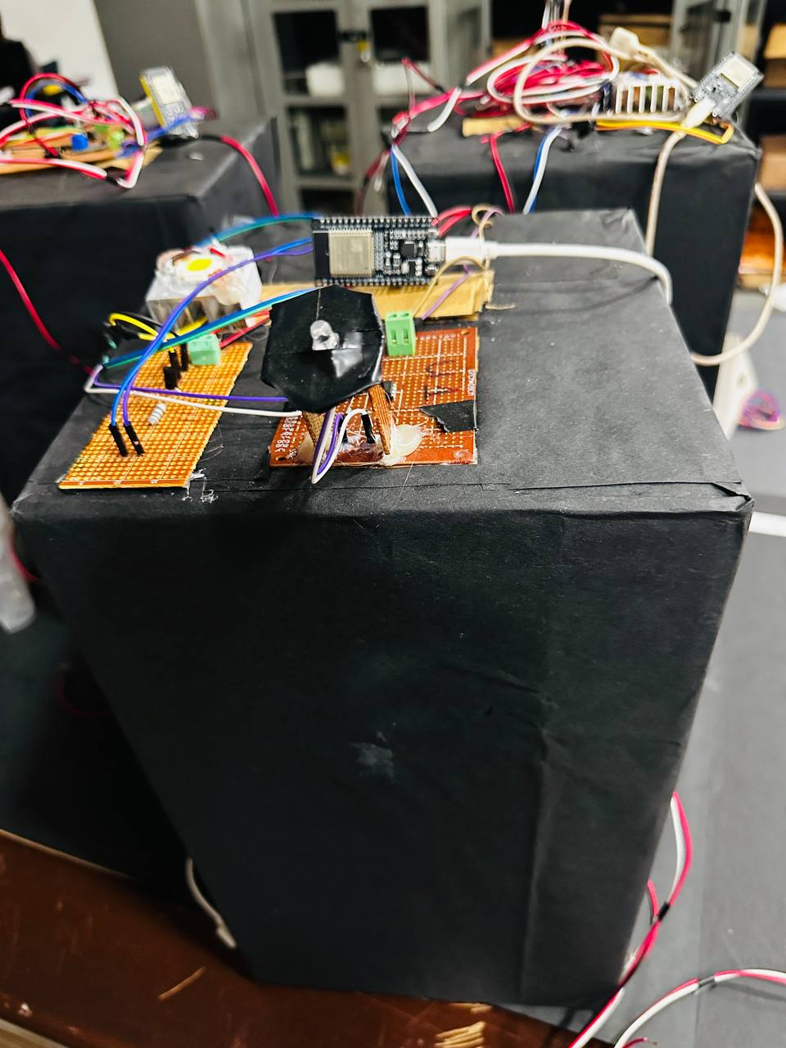
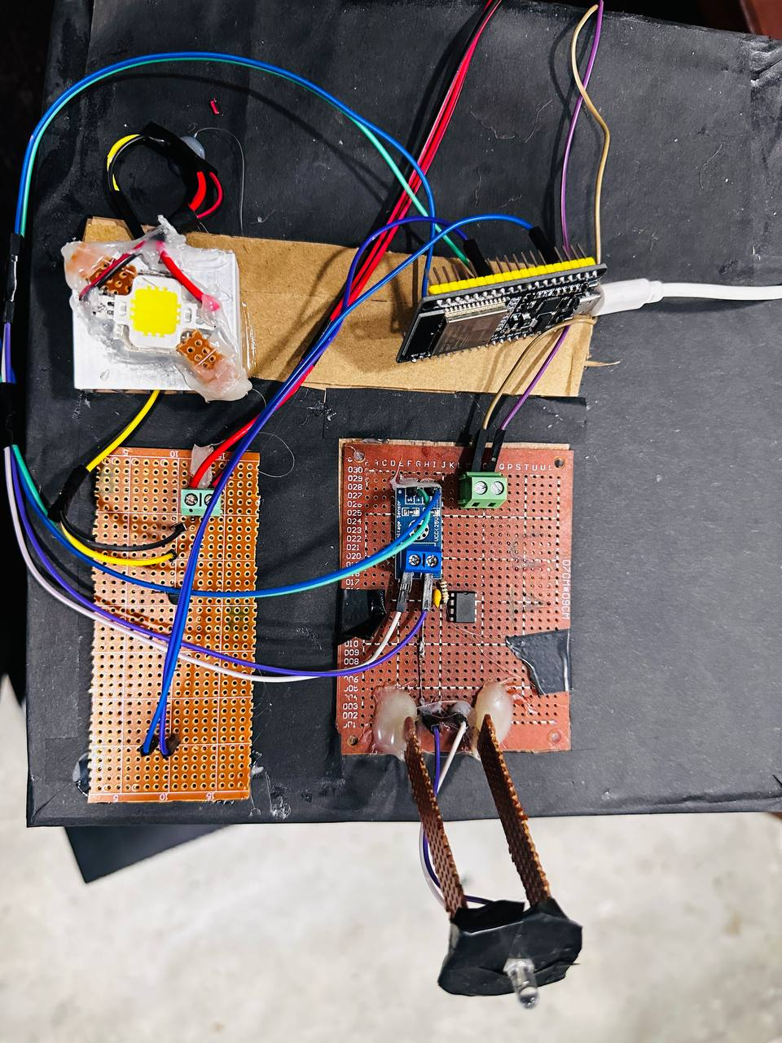
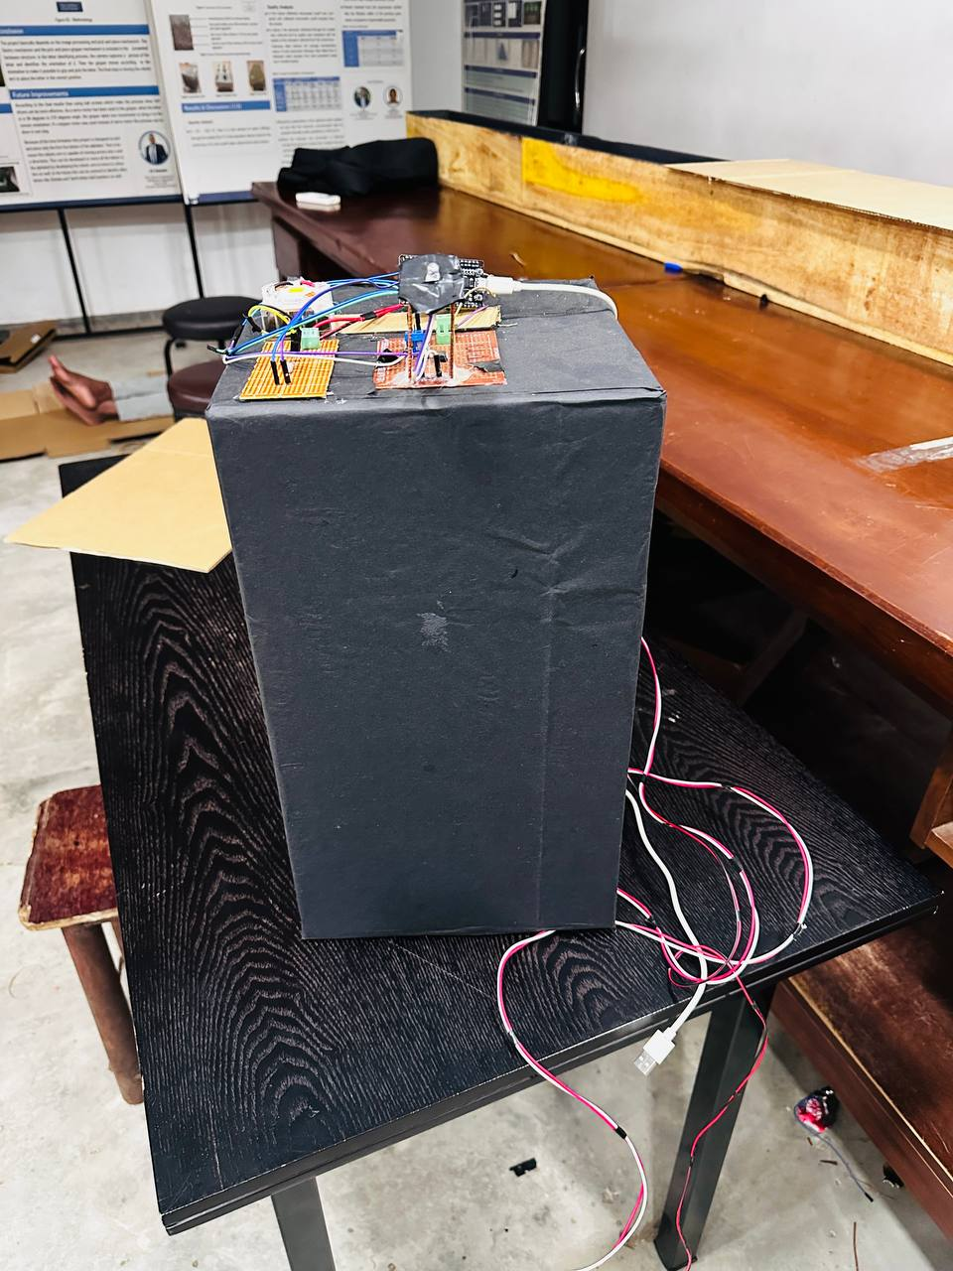
The Basic Architecture of the Project
Transmitter: Motorized Transmitter with User Location Identification Unit
Receiver: Photodiode and Amplifier circuit unit for detecting transmitted light signals.
Beamforming algorithms: Dynamically adjust LED array for optimal transmission detected by photodiodes.

Slide 12
Test Cases & Results
Test cases and the results were collected to a spread sheet and further analysis is on progress,

Slide 13
Discussion

Slide 14
Project Timeline

Slide 15

Budget Plan
 | Component | Quantity | Price ( Rupees)
Transmitter & Receiver | ESP32 Micro Controllers Nema 17 Stepper Motor Nema 23 Stepper Motor 50 W LED 10 W LEDs Photo Diodes ( SPH ) Motor Controllers Electronic Components (D400 Capacitors, LM358 OP-AMPS, Resistors, Wires, Micro USB Cables, Dot boards, Heat sinks) 12V Fan Voltage Sensor | 7 1 1 2 3 7 - 1 7
Setup Cost |  |  | 7000.00
Other |  |  | 6000.00
Total Cost

Slide 16

Thank You !!!

